Slide 1
Computer graphics
Semester 5 – Department of Informatics ITS 2016

Slide 2
Outline
Review Materi Minggu 2
Sistem Grafika
Programmer’s Interface
Arsitektur Sistem Grafika
Programmable Pipeline
Karakteristik Performa
Programming in OpenGL 1: Background
Sesi 1: Complete Programs
Sesi 2: Shaders

Slide 3
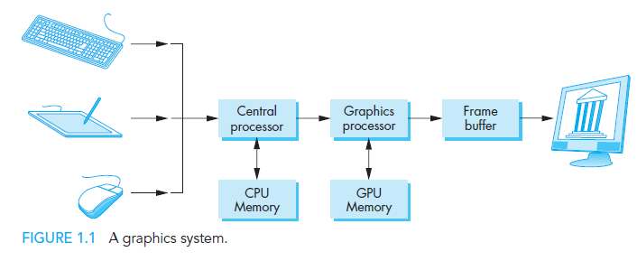
Review: Graphics System
Graphics System
Programmer’s Interface
Graphics System Architecture
Programmable Pipeline
Performance Characteristic

Slide 4
Review: API Contents
Graphics System
Programmer’s Interface
Graphics System Architecture
Programmable Pipeline
Performance Characteristic
Functions that specify what we need to form an image
Objects
Viewer
Light Source(s)
Materials
Other information
Input from devices such as mouse and keyboard
Capabilities of system

Slide 5

Review: Pipeline Architecture
Graphics System
Programmer’s Interface
Graphics System Architecture
Programmable Pipeline
Performance Characteristic
We use pipeline architecture when we will do the same operation on many data sets, just like in computer graphics, large sets of vertices and pixels are processed in the same manner.
Four major steps in the imaging process
Vertex processing
Clipping and primitive assembly
Rasterization
Fragment processing

Slide 6
Review: Pipeline Architecture
Graphics System
Programmer’s Interface
Graphics System Architecture
Programmable Pipeline
Performance Characteristic
Selain pipeline, dikenal pula metode lain dalam mengimplementasikan grafika komputer, seperti ray tracing, radiosity, atau photon mapping.
Kelebihan arsitektur pipeline dibandingkan metode yang lain:
Program aplikasinya dan program GPUnya mudah
Graphics cards melengkapi GPUnya dengan arsitektur pipeline.
Sesuai untuk aplikasi real time/interaktif seperti game, CAD
Kekurangan arsitektur pipeline dibandingkan metode yang lain:
Gambar yang dihasilkan kurang realistis karena tidak memperhitungkan global lighting
Kurang sesuai untuk aplikasi dengan resolusi dan efek realistis yang tinggi, seperti film animasi

Slide 7
Review: Pipeline Architecture
Graphics System
Programmer’s Interface
Graphics System Architecture
Programmable Pipeline
Performance Characteristic
Awalnya berisi fixed functionality
Program aplikasi dapat mengeset banyak parameter fungsi, tetapi operasi dasar yang terdapat didalam pipeline tetap (tidak dapat diubah).
Saat ini baik vertex maupun fragment processor dapat diubah fungsi/operasi dasarnya oleh program aplikasi.
Efeknya banyak efek yang awalnya tidak dapat dihasilkan secara real-time oleh arsitektur pipeline menjadi bisa, seperti bump mapping (dulunya hanya bisa off-line)

Slide 8
Review: Programmable pipeline
Graphics System
Programmer’s Interface
Graphics System Architecture
Programmable Pipeline
Performance Characteristic
Vertex programs can alter the location or color of each vertex as it flows through the pipeline.
Thus, we can implement a variety of light–material models or create new kinds of projections.
Fragment programs allow us to use textures in new ways and to implement other parts of the pipeline, such as lighting, on a per-fragment basis rather than per vertex.

Slide 9
Review Questions
How many color a 1-bit-deep frame buffer allows?
How many color a 8-bit-deep frame buffer allows?
What functions are there in a Graphics Library/API?
State the content of a graphics geometry pipeline architecture and its input, functions and output.
State the difference between pipeline approach and physical based approach in computer graphics.

Slide 10
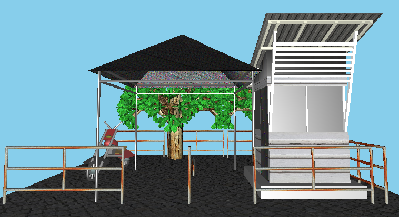
Session 1: Programming in OpenGL: Complete Programs

Slide 11
Objectives
Build a complete first program
Introduce shaders
Introduce a standard program structure
Simple viewing
Two-dimensional viewing as a special case of three-dimensional viewing
Initialization steps and program structure

Slide 12
Program Structure
Most OpenGL programs have a similar structure that consists of the following functions
main():
specifies the callback functions
opens one or more windows with the required properties
enters event loop (last executable statement)
init(): sets the state variables
Viewing
Attributes
initShader(): read, compile, and link shaders
callbacks
Display function
Input and window functions

Slide 13
simple.c revisited
main() function similar to last lecture
Mostly GLUT functions
init() will allow more flexible colors
initShader() will hides details of setting up shaders for now
Key issue is that we must form a data array to send to GPU and then render it

Slide 14
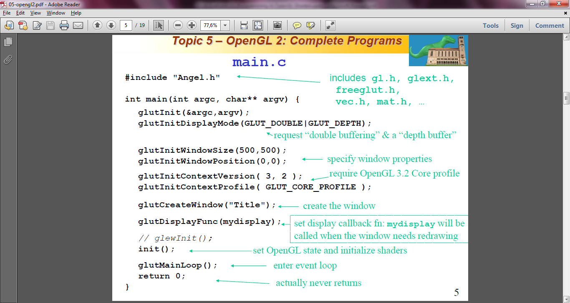
main.c

Slide 15
GLUT functions
glutInit initializes the GLUT system allows it to receive command line arguments (always include this line)
gluInitDisplayMode requests properties for the window (the rendering context)
RGBA color (default) or indexed colour (rare now)
Double buffering (usually) or Single buffering (redraw flickers)
Depth buffer (usually in 3D) stores pixel depths to find closest surfaces [usually with glEnable(GL_DEPTH_TEST);]
Properties are bitwise ORed together with | (vertical bar)
glutInitWindowSize in pixels
glutInitWindowPosition from top-left corner of display

Slide 16
GLUT functions
glutCreateWindow create window with title “Title”
many functions need to be called prior to creating the window
similarly many other functions can only be called afterwards
glutDisplayFunc set display callback
glutKeyboardFunc set keyboard callback
glutReshapeFunc set window resize callback
glutTimerFunc set timer callback
glutIdleFunc set idle callback
glutMainLoop enter infinite event loop
never returns, but may exit

Slide 17
Immediate Mode Graphics
Geometry specified by vertices
Locations in space( 2 or 3 dimensional)
Points, lines, circles, polygons, curves, surfaces
Immediate mode
Each time a vertex is specified in application, its location is sent to the GPU
Old style uses glVertex
Creates bottleneck between CPU and GPU
Removed from OpenGL 3.1

Slide 18
Retained Mode Graphics
Put all vertex and attribute data in array
Send array to GPU to be rendered immediately
Almost OK but problem is we would have to send array over each time we need another render of it
Better to send array over and store on GPU for multiple renderings

Slide 19
Display Callback
Once we get data to GPU, we can initiate the rendering with a simple callback
void mydisplay()
{
glClear(GL_COLOR_BUFFER_BIT);
glDrawArrays(GL_TRIANGLES, 0, 3);
// glFlush(); // Single buffering
glutSwapBuffers(); // Double buffering
}
Arrays are buffer objects that contain vertex arrays

Slide 20
Vertex Arrays
Vertices can have many attributes
Position
Color
Texture Coordinates
Application data
A vertex array holds these data
Using types in vec.h
point2 vertices[3] = {point2(0.0, 0.0),
point2( 0.0, 1.0), point2(1.0, 1.0)};

Slide 21
Vertex Array Object
Bundles all vertex data (positions, colors, ..,)
Get name for buffer then bind
GLunit abuffer;
glGenVertexArrays(1, &abuffer);
glBindVertexArray(abuffer);
At this point we have a current vertex array but no contents
Use of glBindVertexArray lets us switch between VBOs

Slide 22
Buffer Object
Buffers objects allow us to transfer large amounts of data to the GPU
Need to create, bind and identify data
GLuint buffer;
glGenBuffers(1, &buffer);
glBindBuffer(GL_ARRAY_BUFFER, buffer);
glBufferData(GL_ARRAY_BUFFER,
sizeof(points), points);
Data in current vertex array is sent to GPU

Slide 23
Initialization
Vertex array objects and buffer objects can be set up on init()
Also set clear color and other OpenGL parameters
Also set up shaders as part of initialization
Read
Compile
Link
First let’s consider a few other issues

Slide 24
Coordinate Systems
The units in points are determined by the application and are called object, world, model or problem coordinates
Viewing specifications are also in object coordinates and it is the size of the viewing volume that determines what will appear in the image
Eventually, pixels will be produced in screen coordinates (a.k.a. window coordinates)
OpenGL shaders also often use some internal representations that usually are not visible to the application, such as camera coordinates (generally prior to perspective transformation)

Slide 25
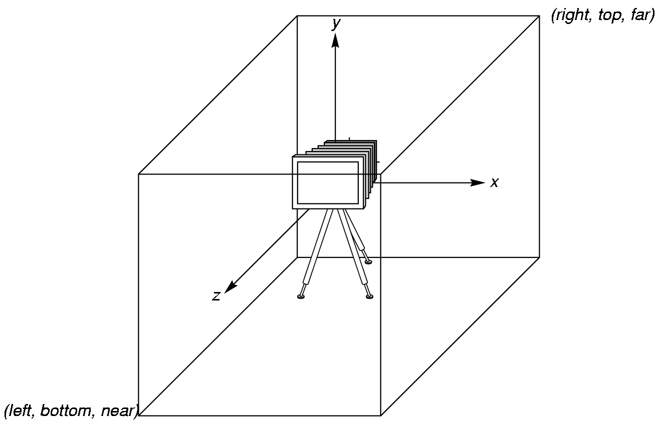
OpenGL Camera
OpenGL places a camera at the origin in object space pointing in the negative z direction
The default viewing volume
is a box centered at the
origin with a side of
length 2

Slide 26
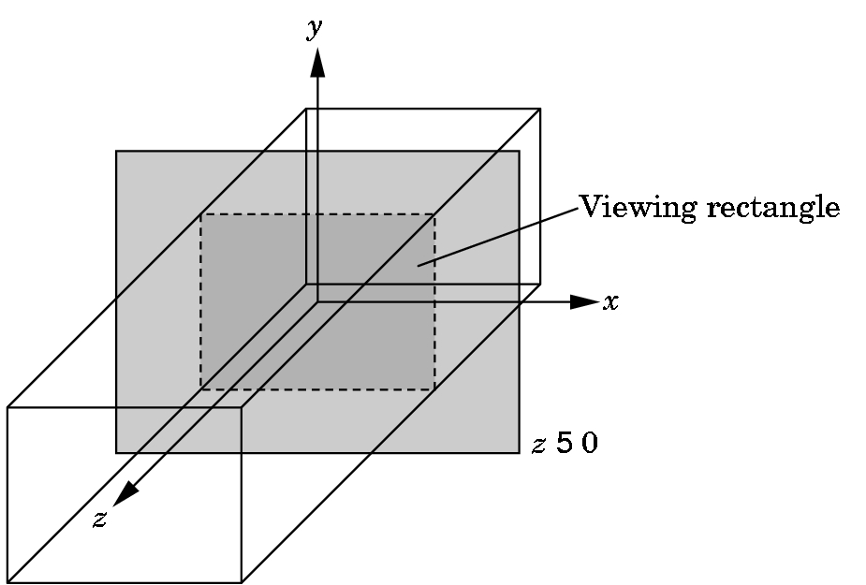
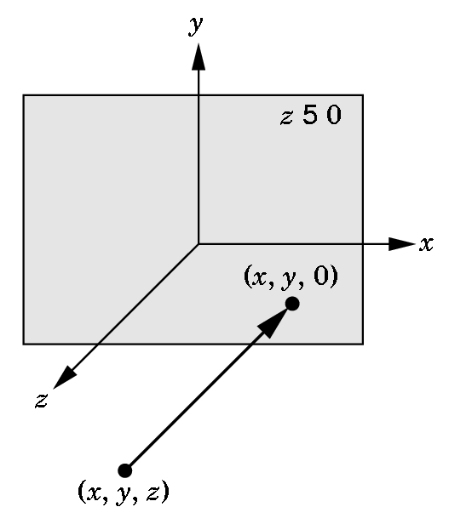
Orthographic Viewing
In the default orthographic view, points are
projected forward along the z axis onto the
plane z=0
z=0
z=0

Slide 27
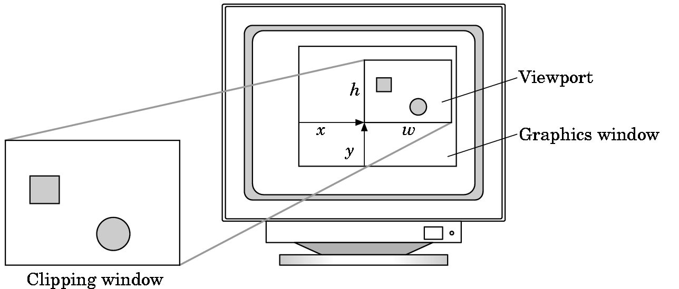
Viewports
Do not have use the entire window for the image: glViewport(x,y,w,h)
Values in pixels (screen/window coordinates)

Slide 28
Transformations and Viewing
In OpenGL, projection is carried out by a projection matrix (transformation)
Transformation functions are also used for changes in coordinate systems
Pre 3.0 OpenGL had a set of transformation functions which have been deprecated
Three choices in OpenGL 3+
Application code
GLSL functions
vec.h and mat.h

Slide 29
Session 2: Programming in OpenGL: Shaders

Slide 30
Objectives
Simple Shaders
Vertex shader
Fragment shader
Programming shaders with GLSL
Finish first program

Slide 31
Vertex Shader Applications
Geometric transformations
Change relative location, rotation, scale of objects/camera
3D perspective transformation – make far objects smaller
Moving vertices
Morphing
Wave motion & deformation due to physical forces
Particle effects – for fire, smoke, rain, waterfalls, …
Fractals
Lighting
Calculate shading color using light and surface properties
Can choose between less/more realistic models (unlike the fixed pipeline)
Cartoon shaders, other special effects

Slide 32
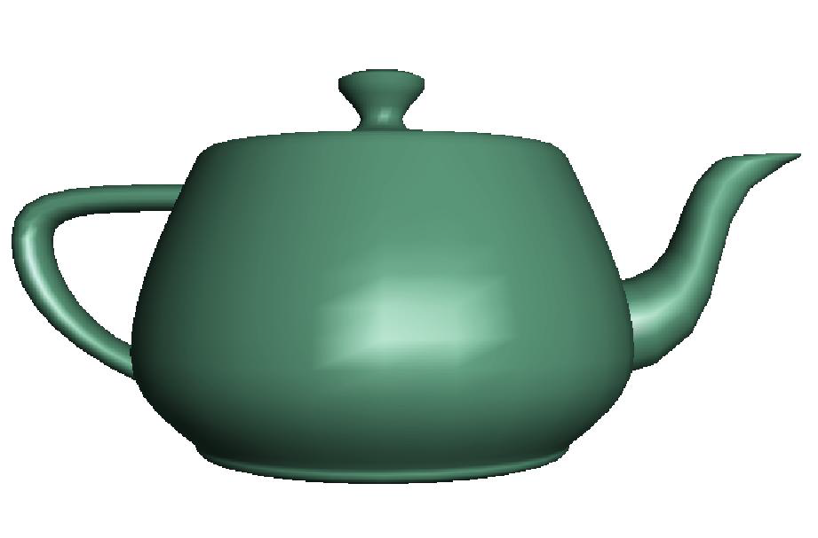
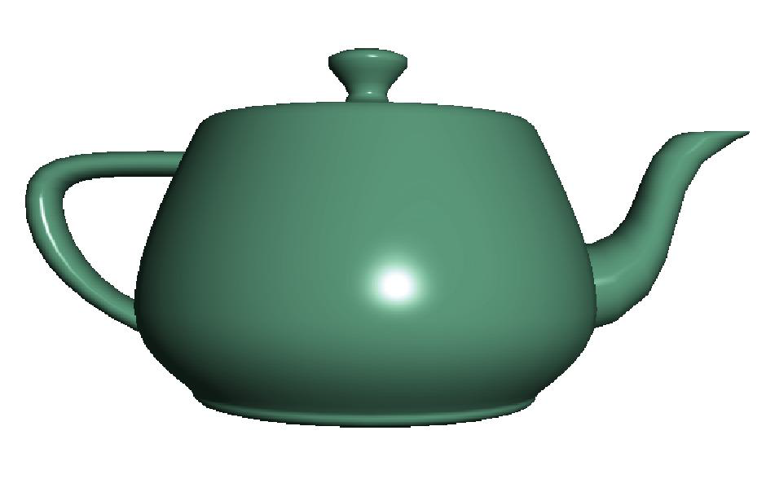
Fragment Shader Applications
Per fragment lighting calculations
per vertex lighting per fragment lighting

Slide 33
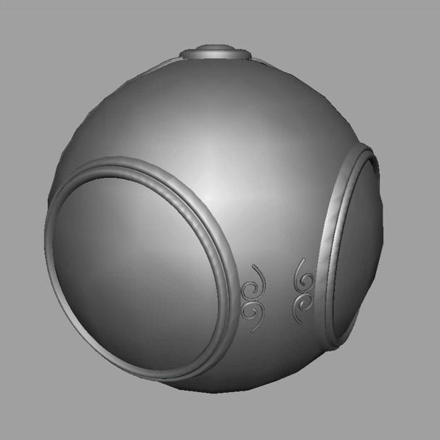

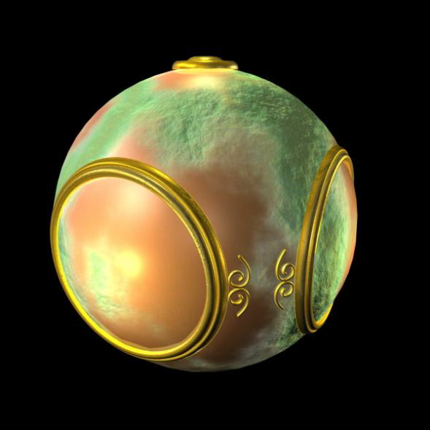
Fragment Shader Applications
Texture mapping
smooth shading environment mapping bump mapping

Slide 34
Writing Shaders
First programmable shaders were programmed in an assembly-like manner
OpenGL extensions added for vertex and fragment shaders
Cg (C for graphics) C-like language for programming shaders
Works with both OpenGL and DirectX
Interface to OpenGL complex
OpenGL Shading Language (GLSL)

Slide 35
GLSL
OpenGL Shading Language
Part of OpenGL 2.0 and up
High level C-like language
New data types
Matrices
Vectors
Samplers
As of OpenGL 3.1, application must provide shaders

Slide 36
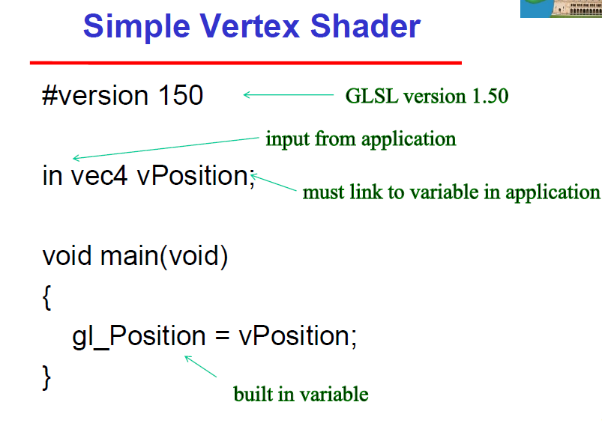
Simple Vertex Shader

Slide 37
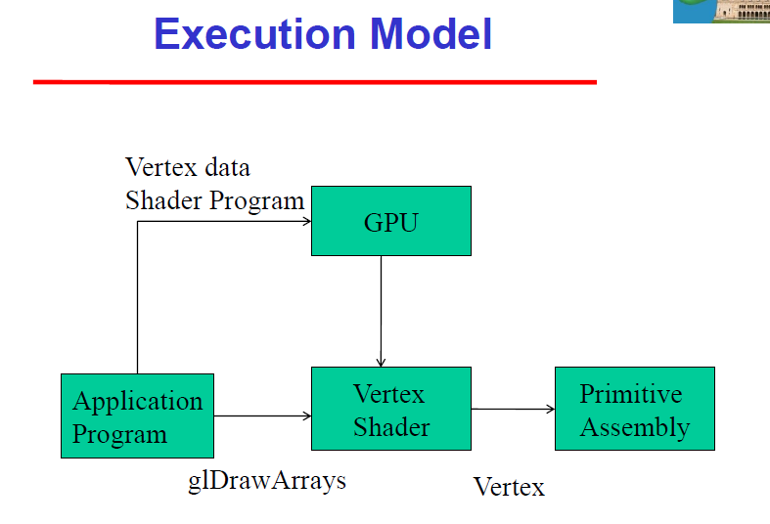

Slide 38
Simple Fragment Program
#version 150
out vec4 fragcolor;
void main(void) {
fragcolor = vec4(1.0, 0.0, 0.0, 1.0);
}

Slide 39
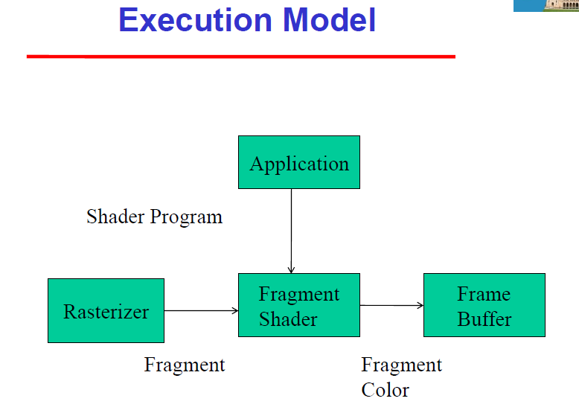

Slide 40
Data Types
C types: int, float, bool
Vectors:
float vec2, vec3, vec4
Also int (ivec) and boolean (bvec)
Matrices: mat2, mat3, mat4
Stored by columns
Standard referencing m[row][column]
C++ style constructors
vec3 a =vec3(1.0, 2.0, 3.0)
vec2 b = vec2(a)

Slide 41
Pointers
There are no pointers in GLSL
We can use C structs which can be copied back from functions
Because matrices and vectors are basic types they can be passed into and output from GLSL functions, e.g.
mat3 func(mat3 a)

Slide 42
Qualifiers
GLSL has many of the same qualifiers such as const as C/C++
Need others due to the nature of the execution model
Variables can change
Once per primitive
Once per vertex
Once per fragment
At any time in the application
Vertex attributes are interpolated by the rasterizer into fragment attributes

Slide 43
Attribute Qualifier
Attribute-qualified variables can change at most once per vertex
There are a few built in variables such as gl_Position but most have been deprecated
User defined (in application program)
Use in qualifier to get to shader
in float temperature
in vec3 velocity

Slide 44
Uniform Qualified
Variables that are constant for an entire primitive
Can be changed in application and sent to shaders
Cannot be changed in shader
Used to pass information to shader such as the bounding box of a primitive

Slide 45
Varying Qualified
Variables that are passed from vertex shader to fragment shader
Automatically interpolated by the rasterizer
Old style used the varying qualifier
varying vec4 color;
Now use out in vertex shader and in in the fragment shader
out vec4 color;

Slide 46
Example: Vertex Shader
#version 150
const vec4 red = vec4(1.0, 0.0, 0.0, 1.0);
in vec4 vPosition;
out vec4 color_out;
void main(void)
{
gl_Position = vPosition;
color_out = red;
}

Slide 47
Required Fragment Shader
#version 150
in vec4 color_out;
out vec4 fragcolor;
void main(void) {
fragcolor = color_out;
}
// in pre-OpenGL 3.2 versions use built-in:
// gl_FragColor = color_out;

Slide 48
Passing values
call by value-return
Variables are copied in
Returned values are copied back
Three possibilities
in
out
inout (deprecated)

Slide 49
Operators and Functions
Standard C functions
Trigonometric
Arithmetic
Normalize, reflect, length
Overloading of vector and matrix types
mat4 a;
vec4 b, c, d;
c = b*a; // a column vector stored as a 1d array
d = a*b; // a row vector stored as a 1d array

Slide 50
Swizzling and Selection
Can refer to array elements by element using [] or selection (.) operator with
x, y, z, w
r, g, b, a
s, t, p, q
a[2], a.b, a.z, a.p are the same
Swizzling operator lets us manipulate components
vec4 a;
a.yz = vec2(1.0, 2.0);

Slide 51
Next Week: Programming in OpenGL: Polygons & Attributes
Also Programming in OpenGL: More GLSL
Read the Textbook Ch. 2 (pp 56 – 90)

